Slide 1


Epidemic Networks
Garrettlab.com
garrettlab.com

Slide 2
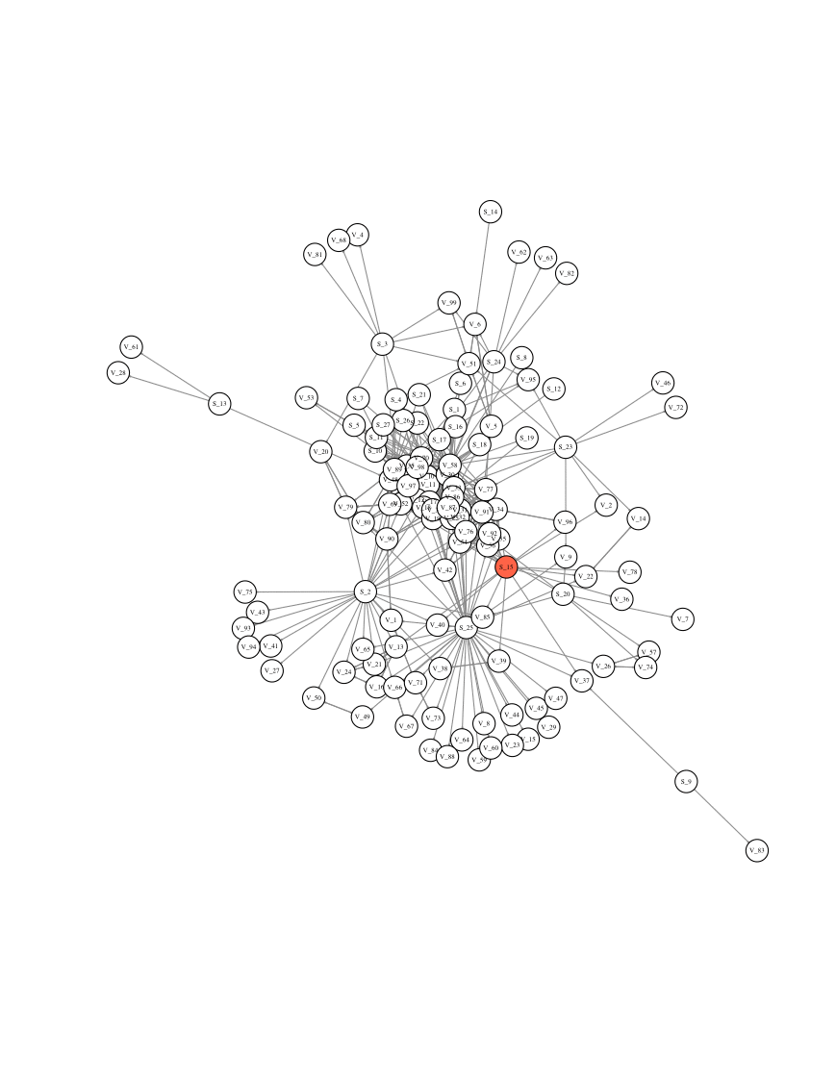
Learning Goals
Why networks can be useful for modeling epidemics
Advantages and disadvantages of network analysis
Network property examples
R code!

Slide 3
Network Models for Epidemics
Network models are effective tools for modeling human, animal, and plant diseases
Links:
The movement of pathogens between nodes
Probability of infection
Links can be weighted
Can be dynamic or fixed
Can vary over time (formation and dissolution)
Can be generated based on empirical trade data
Or modeled
Nodes can be:
Genes
Plants
Farms
Farmers
Communities
Landscapes
Nations

Slide 4
Network models vs. Standard Differential Equation Models (SIR, for example)
Anuwat Wiratsudakul, et al 2018

Slide 5
Advantages and disadvantages of network models
Advantages
Realistic contact structures between individuals
Can accurately capture trade patterns
Geo-spatial connectivity
Social influence
Disadvantages
Data availability - difficult to sample a complete large network
Sampling
Effect of aggregation

Slide 6
Examples of Questions One Might Ask with Network Models of Epidemics:
Given what we know about a geographic network, what are the best locations for risk based pathogen surveillance?
Are there locations that are super-spreaders?
How do social processes affect plant disease dispersal?

Slide 7
Network descriptives may tell us some about epidemic risk in networks
Measure | Definition | Relevance for Epidemics
Degree Centrality | The number of links a node has to other nodes in the network (both incoming and outgoing) | Node degree of epidemic starting point (number of links) has been shown to influence epidemic outcomes. Those with high degree may be “super spreaders” once infected
Betweenness centrality | The number of shortest paths through the network of which a node is a part | A measure of how much a node serves as a “bridge” to new nodes. Removal of nodes with high betweenness may contain an epidemic within a region
Eigenvector centrality | A weighted sum reflecting both direct links to a node (degree) and the node degree of neighbors | If a node does not itself have a high node degree, but is connected to nodes with high degree, it may be at increased risk of infection and spreading infection
Closeness Centrality | The inverse of the average length of the shortest path to/from all the other nodes in the network | Efficiency of the node to spread disease to any other node in the network

Slide 8
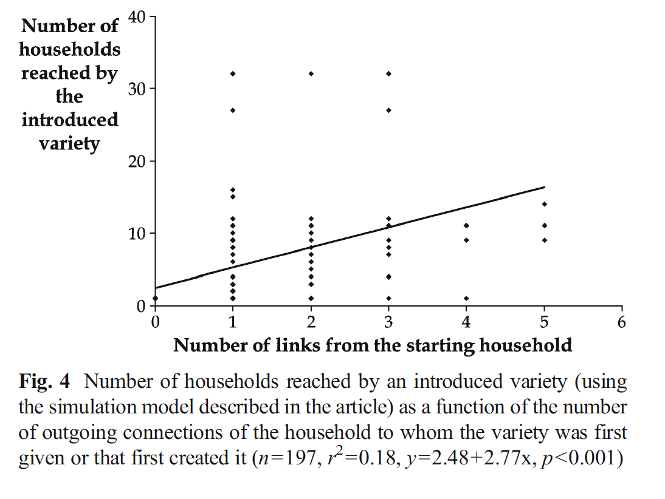
Node statistics and epidemic outcomes Case: variety spread in seed networks
Study looking at barley seed flows in Ethiopia
Findings indicate that the node degree of the starting households drives the final number of households reached
Important implications for epidemic spread in seed systems
Marco Pautasso 2015

Slide 9
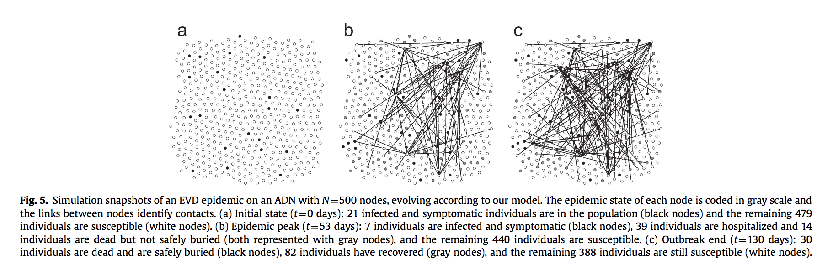
Used for many years in human epidemiology Case: 2014 Ebola Outbreak
Modeling Ebola spread combining SEIR model with network-based model
Overcomes the assumption of homogeneous mixing of other Ebola models
Calibrated with field data from 2014 Liberia
Modeled a one year forecast of disease spread along with what-if scenario analysis to assess intervention strategies
Rizzo et al 2016

Slide 10
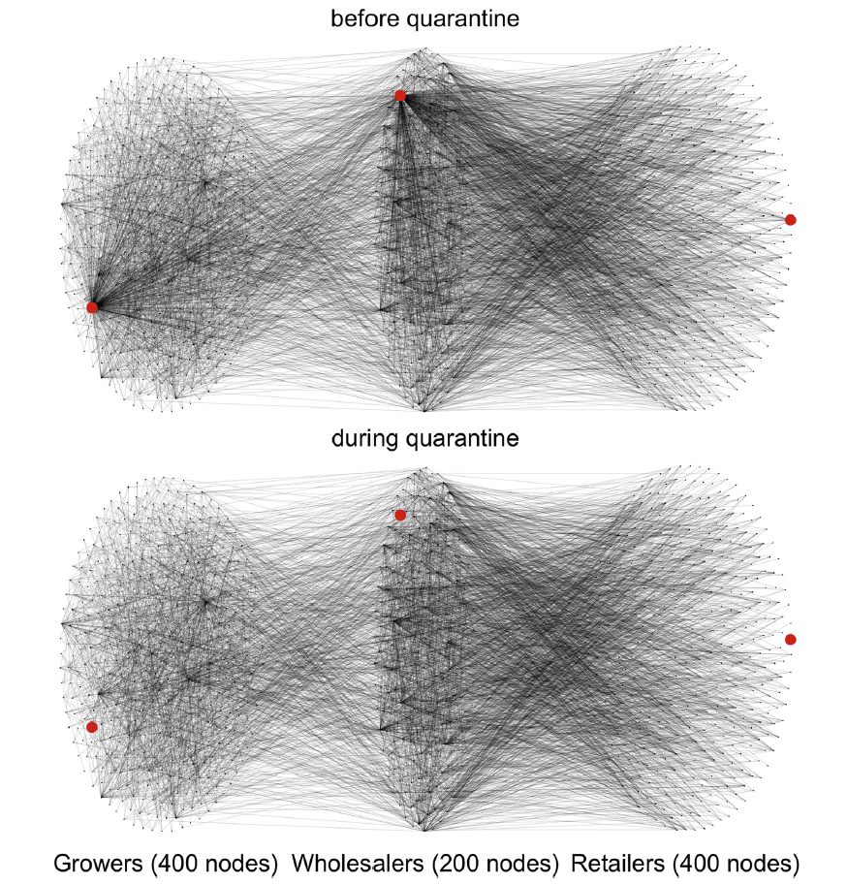
Epidemics in horticultural trade networks
Multi-layer network that looked at growers, wholesalers, and retailers
Once infection was detected, infected nurseries were isolated until infection dropped below a detection threshold
Focusing epidemics on hub growers is most useful for controlling spread
Nelson & Boone 2015

Slide 11
Exponential Random Graph Models (ERGMs)

Slide 12
Concept: Exponential Random Graph Models (ERGMs)
Consider sampled network data on edges between yellow and gray nodes
Statistical modeling framework to understand the generative process driving link formation in a network that deviates from random
Predicts probability of a link, conditional on the structure of the rest of the network
Does this differ from simple random graphs with the same number of nodes and links (10 million possible)?
Notes:
Mathmatical models are useful, but there is also the potential for the application of statistical models to epidemic network modeling. Expoential random graph models have been utilized for many years in the

Slide 13
Exponential random graph models (ERGMs)
Fit using Monte Carlo Markov Chain maximum likelihood estimation
Predictor types (and examples of hypotheses)
Node - H: node of type X is more likely to have a link than other types of nodes
Dyad- H: nodes of type X and Y are more likely to have a link between them
Relation- H: a node with link type X is more likely to have link type Y

Slide 14
ERGM Model Specification
Useful R Packages:
statnet()
ergm()
stergm()
Null model: a random graph model
Network ~ edges
Single model term analogous to the intercept in a regression model
The null model fit can be compared to the fit of more complicated models
Compare models using statistics like AIC and BIC, to evaluate the trade-off between adding more parameters and improving the model fit
Simulate networks based on specified network models- important for using sampled seed system data to estimate the larger network

Slide 15







Slide 16
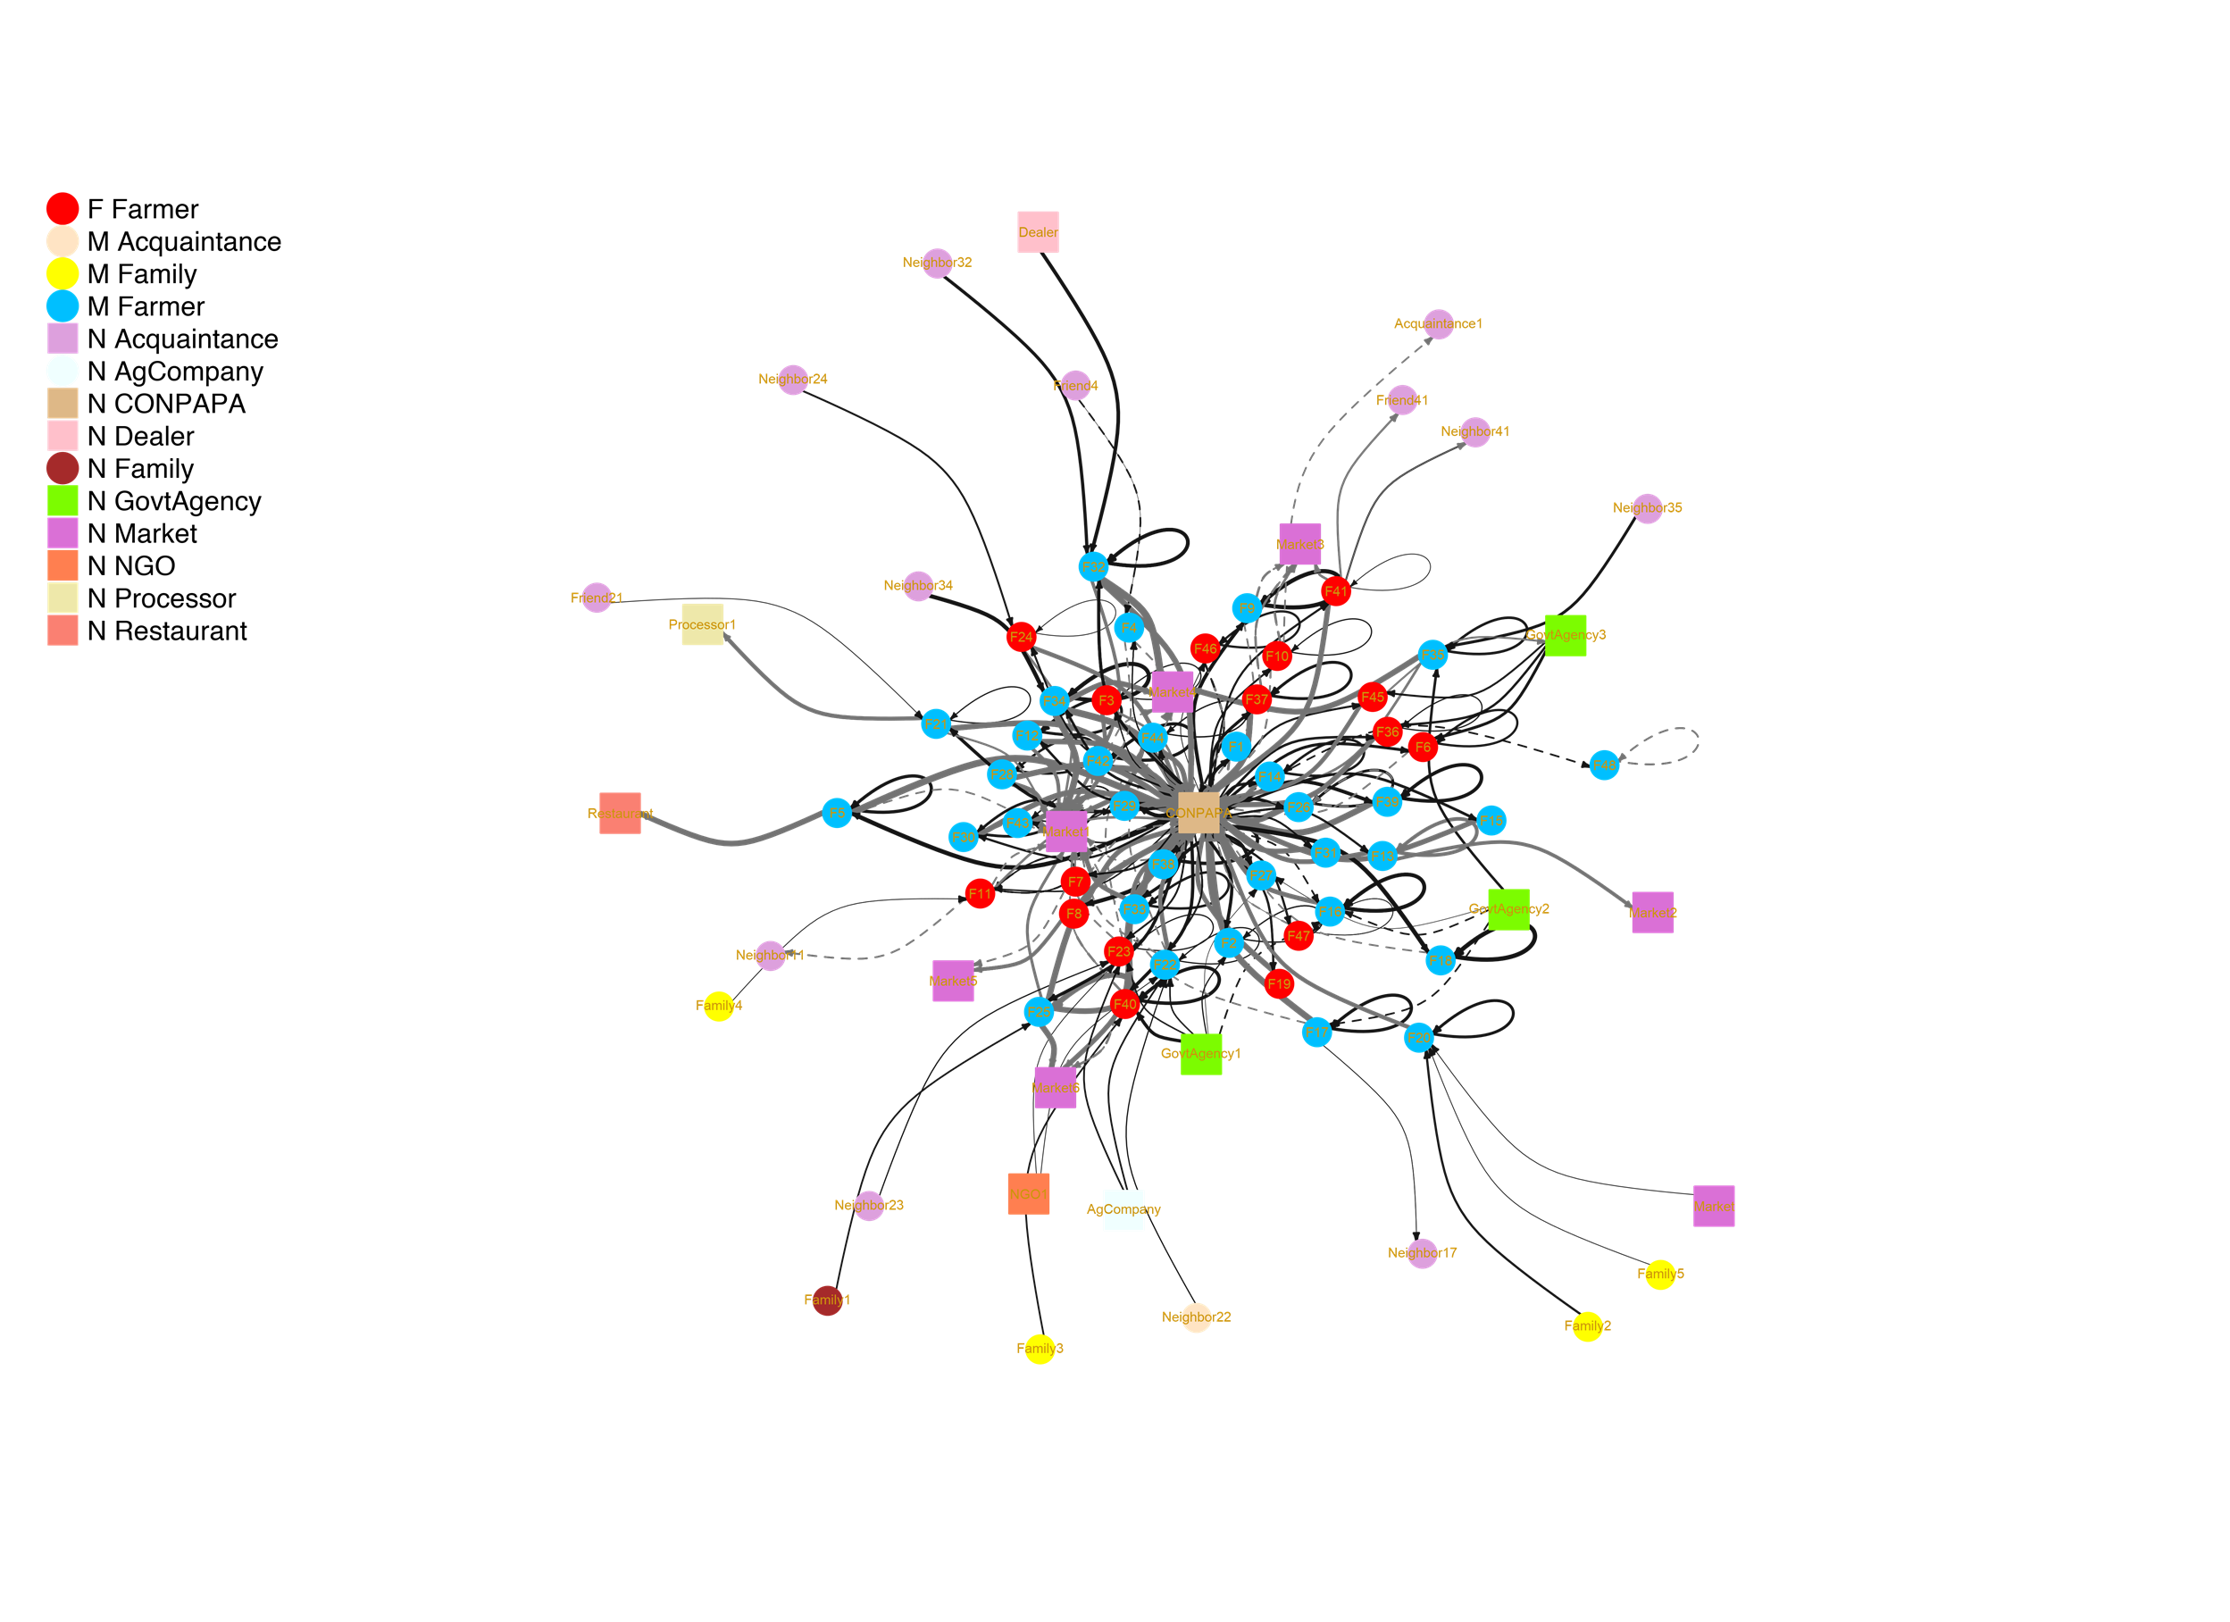
Ecuador Seed Network

Slide 17
In the potato seed system in Ecuador, what is the effect of node type on the probability that a link exists?
Model:
Y ~ edges + nodematch(“gender”) + nodematch (“type”) + mutual + idegrange(1) + gwidegree(1)
Node type had an effect on the likelihood that reported links exist in the potato transaction network (P < 0.0001).
Farmers were much more likely to report transaction links with institutions (like CONPAPA) than with other farmers.

Slide 18
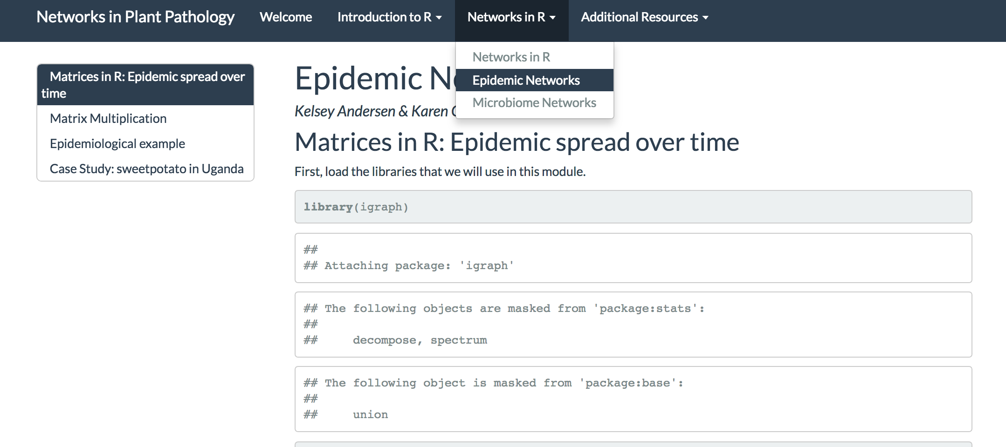
Let’s move to the markdown! kelseyandersen.github.io/NetworksPlantPathology/

